Slide 1

High Impact Skills Development Program
in Artificial Intelligence, Data Science, and Blockchain
Module 1: [AI Fundamentals]
Lecture 1: Regression Models
Instructor: Dr. Junaid Younas
Assistant Professor, SEECS, NUST

Slide 2
Agenda of the day
Regression
Types of Regression
Overfitting and under fitting issues
Methods to overcome these issue

Slide 3
Agenda of the day
Machine learning
Supervised learning
Classification
Regression
Unsupervised learning
Linear Regression
Logistic Regression
Polynomial Regression

Slide 4
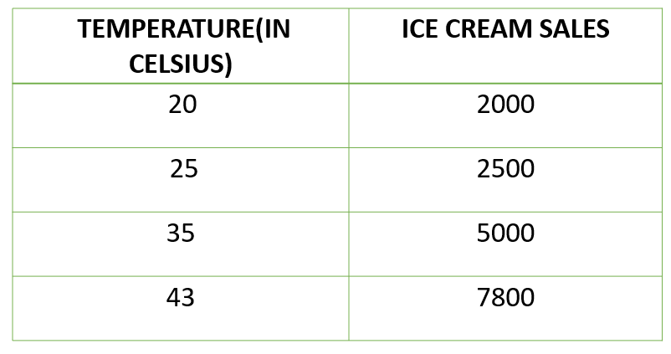

Some basic Terminologies to remember
Notations
x input data variable features, PRIDICTOR
y output data variable features, TARGET
Ŷ output of Classifier
m total number of training samples
(x, y) single training example
${(x}^{i},y^{i}) i^{th}$ training example
x
model
ŷ
f(x)
f(x)= wx+b

Slide 5
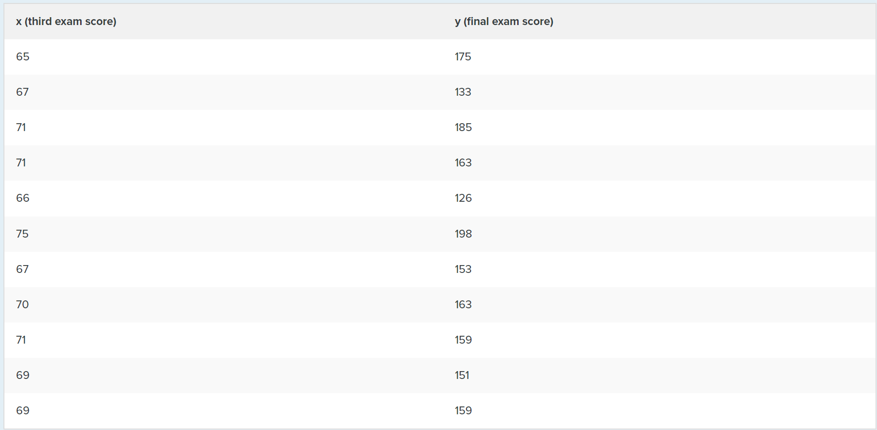
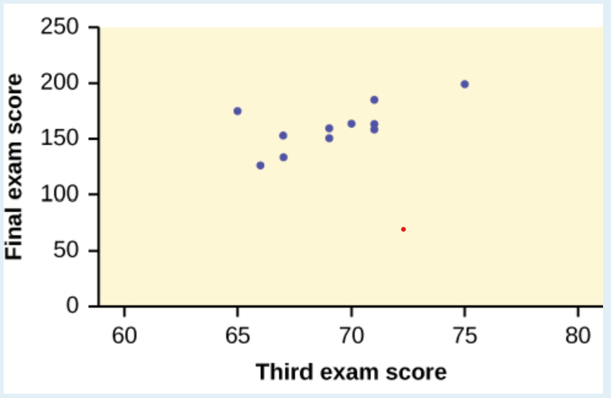
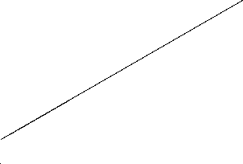
Regression
A machine learning method commonly used for predictions
Uses statistical models to find the relationships between dependent variable (y) and independent variable(x)
Regression is used for
Prediction
Forecasting
Time series modelling
Causal-effect relationship

Slide 6
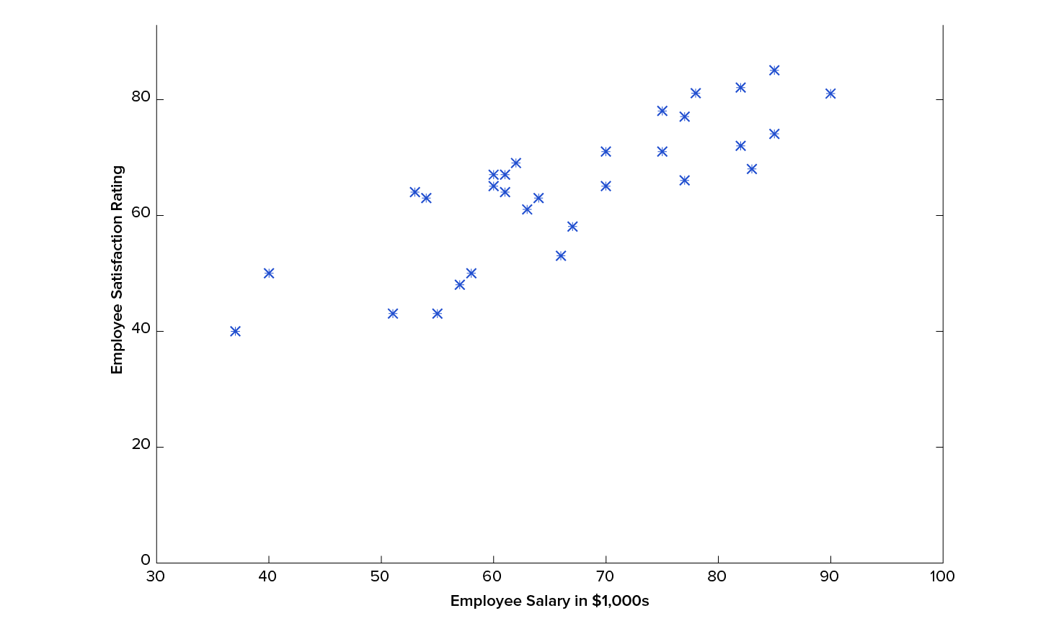
Linear Regression: Draws the linear relationships between Target and Predictor
A very simple and easy technique commonly used for predictive analysis
Uses linear function to draw the line
f(x)=ax+b

Slide 7
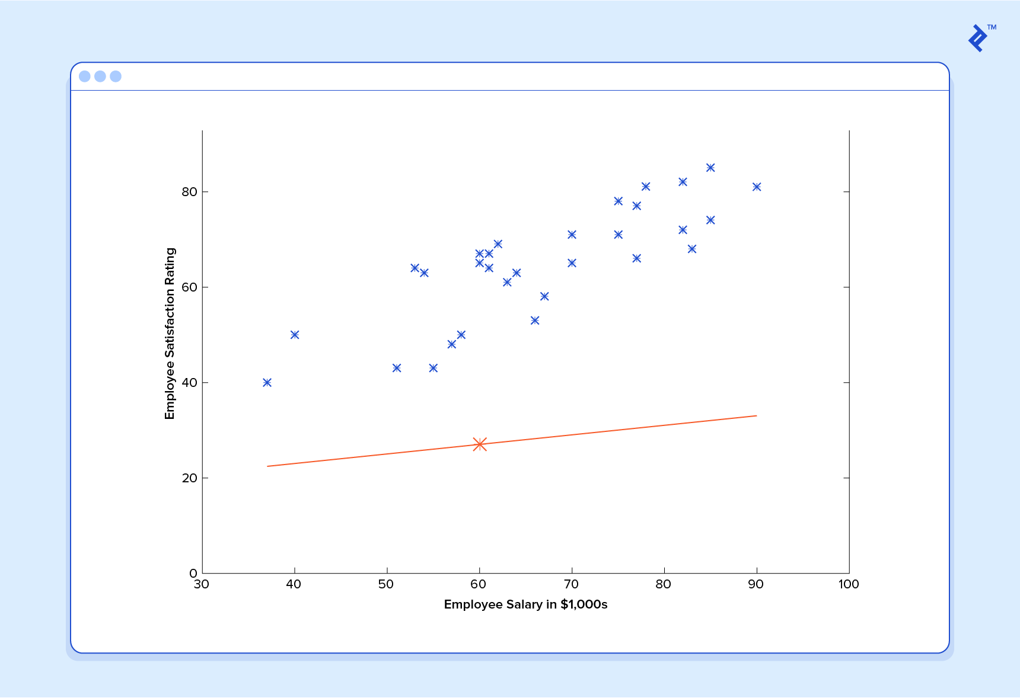
f(x)= 0.2x+12.00

Slide 8
f(x)= 0.2x+12.00

Slide 9
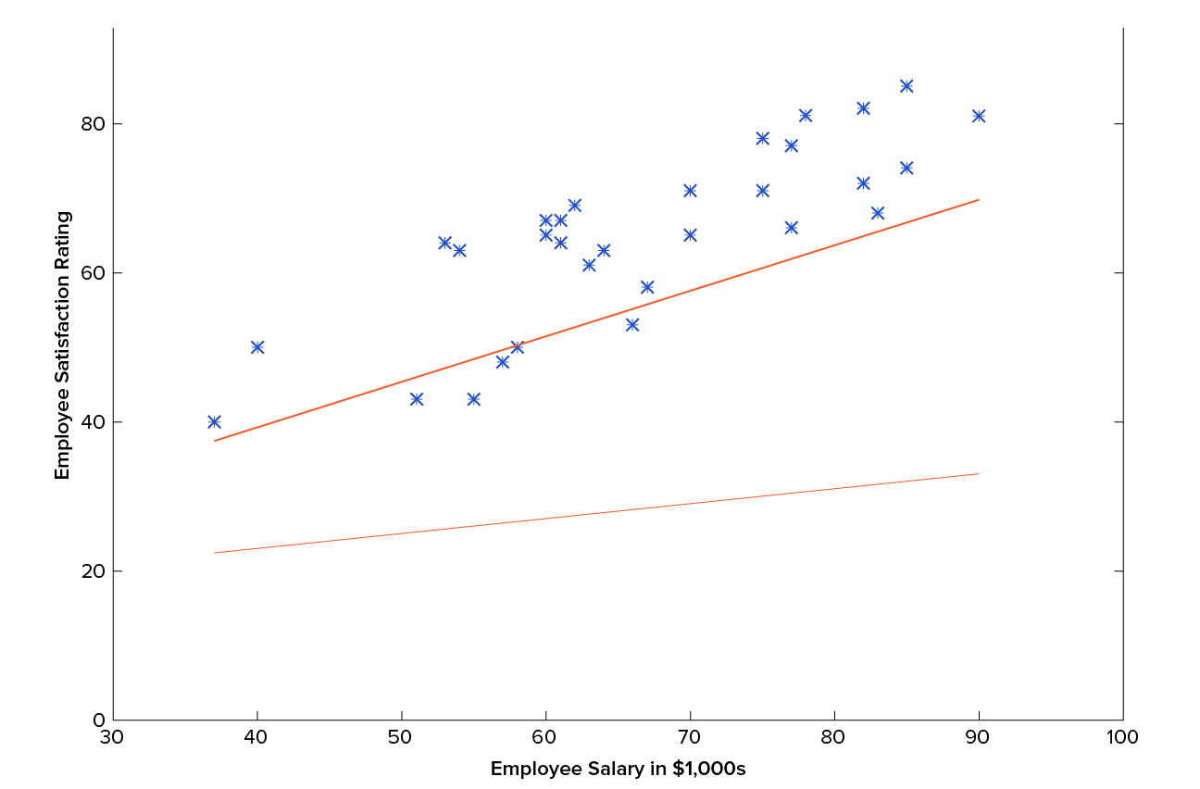
f(x)= 0.61x+13.12

Slide 10
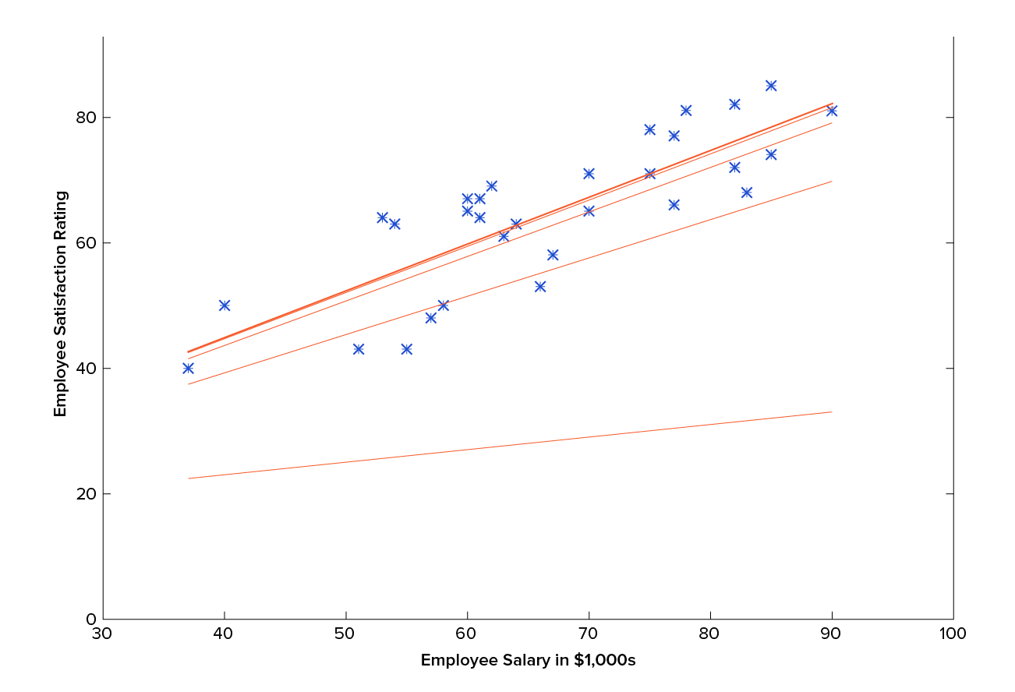
f(x)= 0.75x+15.14

Slide 11

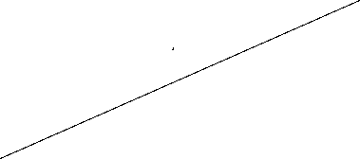
Problem with linear regression

Slide 12
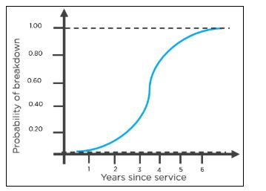
Logistic Regression
Commonly used for classification purposes
Works only for discrete dependent variables
It uses the logit function, common one is Sigmoid function
Works well when data is linearly separable

Slide 13
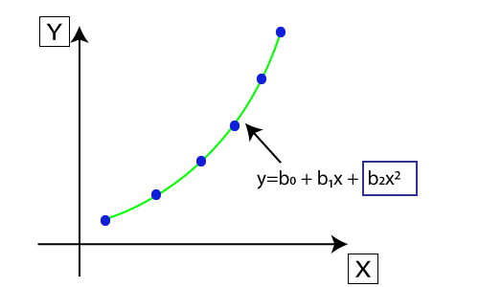
Polynomial Regression
Models the nonlinear dataset using a linear model
Original features are transformed into polynomial features of given degree
Function for polynomial regression is derived from linear regression

Slide 14
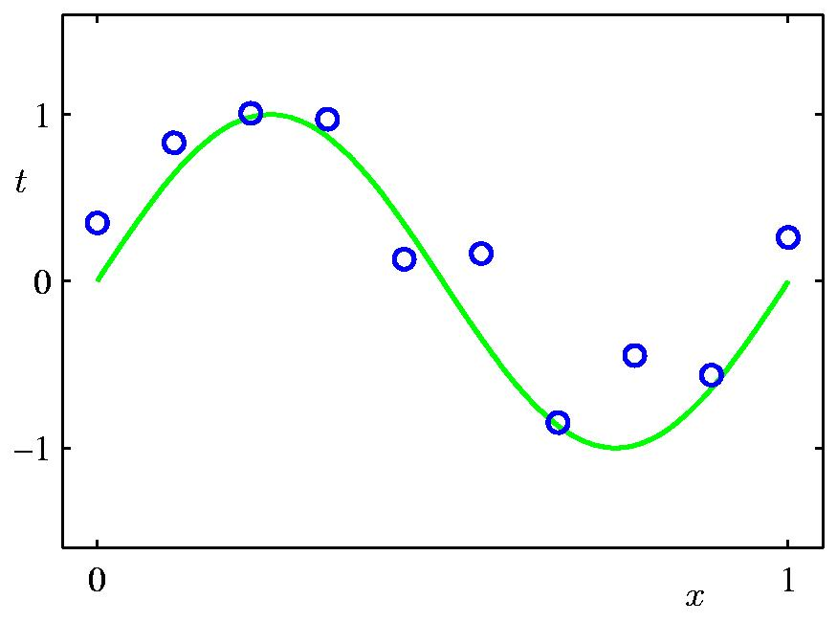
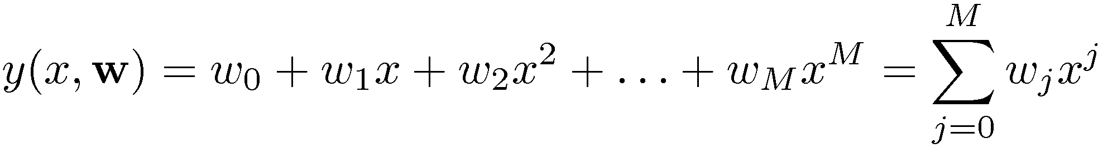
Polynomial Regression

Slide 15
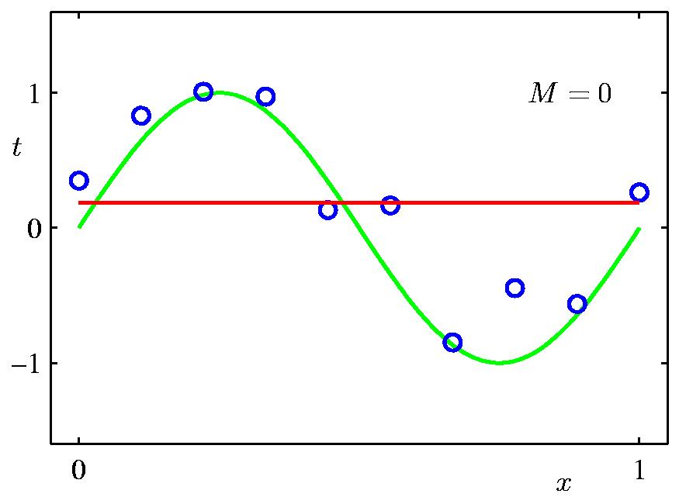
0-th order Polynomial

Slide 16
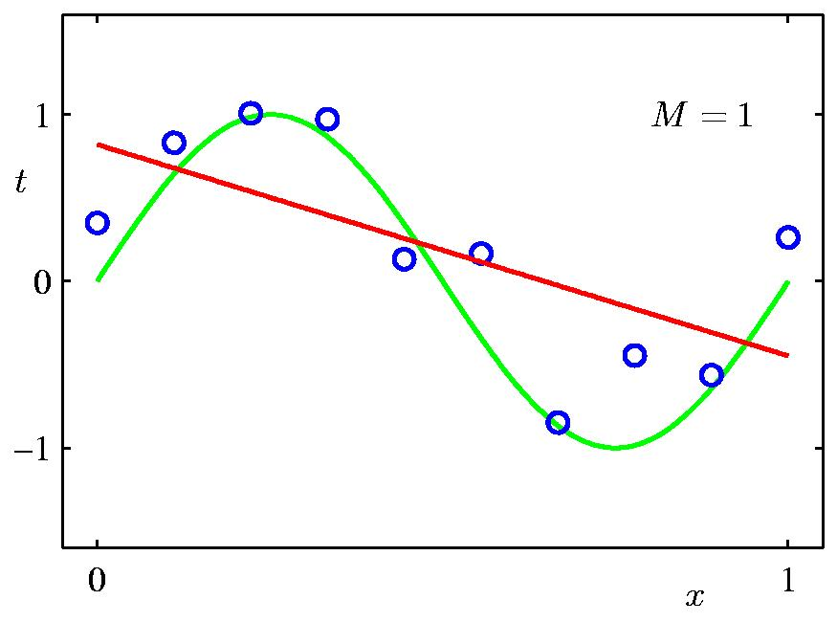
1st Order Polynomial
Same as linear regression

Slide 17
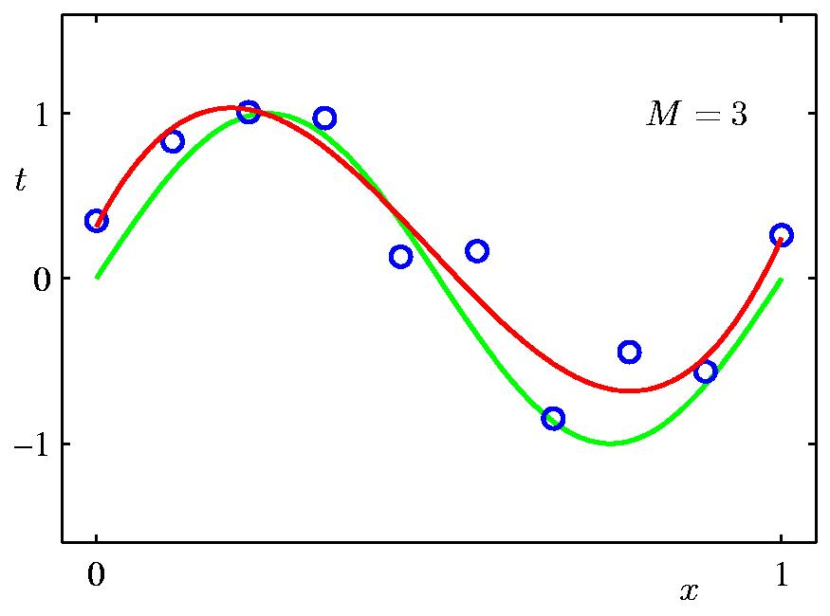
3rd Order Polynomial

Slide 18
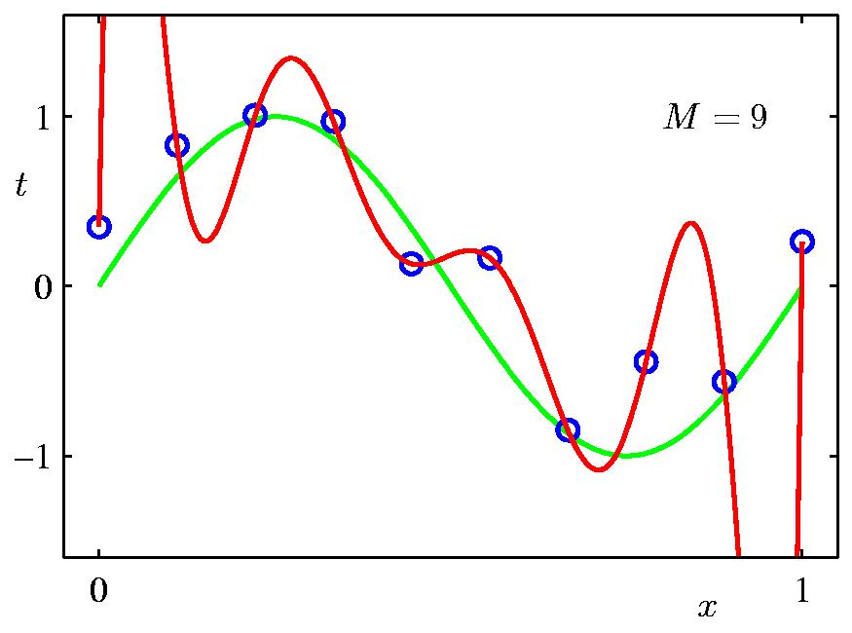
9th Order Polynomial

Slide 19
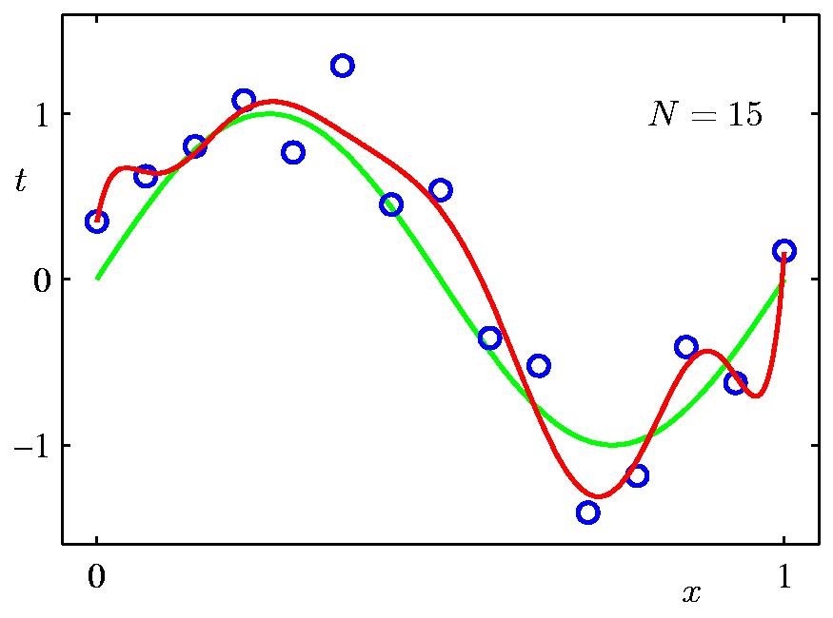
Data Set Size:
9th Order Polynomial fitted on 15 samples

Slide 20
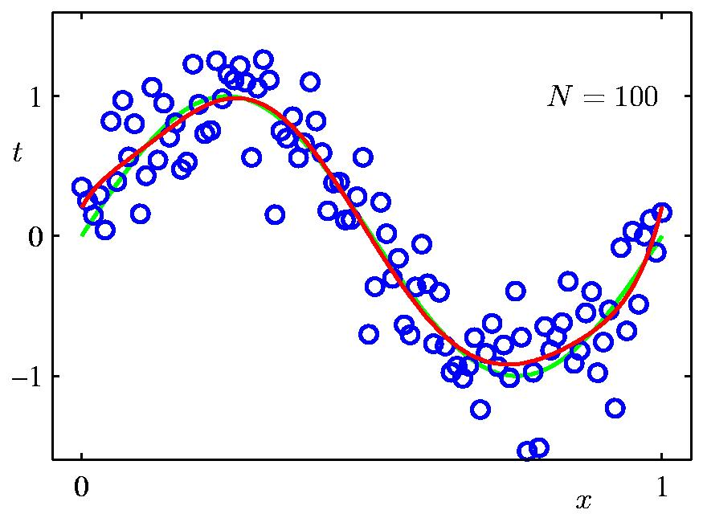
Data Set Size:
9th Order Polynomial fitted on 100 samples

Slide 21
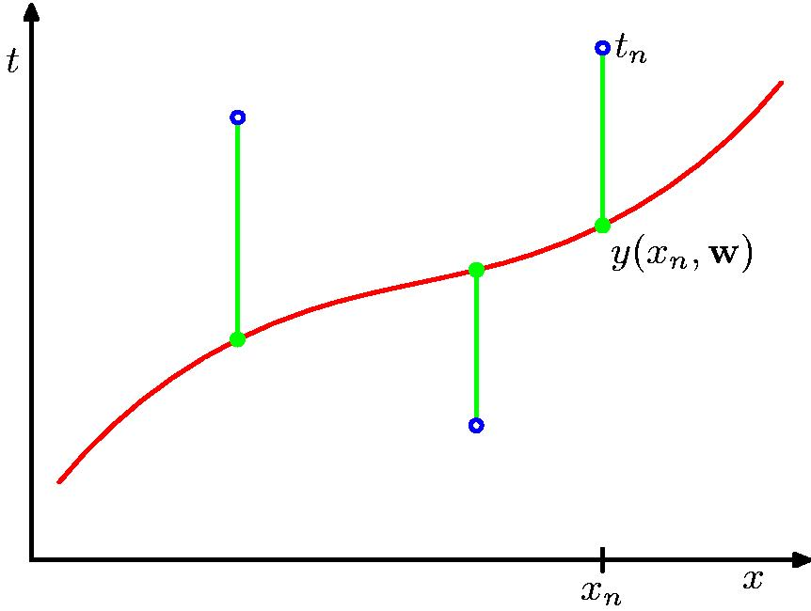
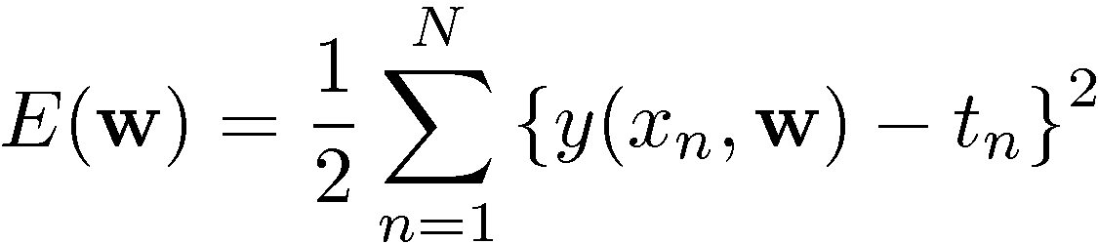
Sum-of-Squares Error Function

Slide 22
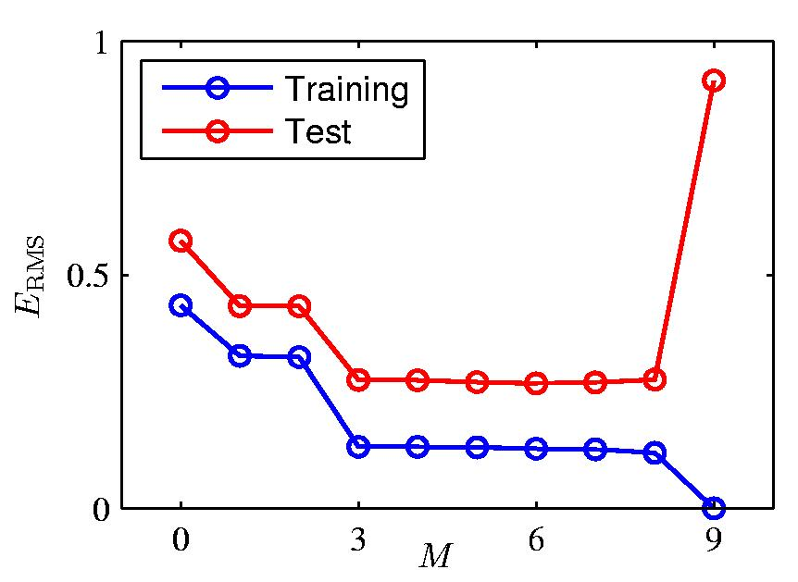
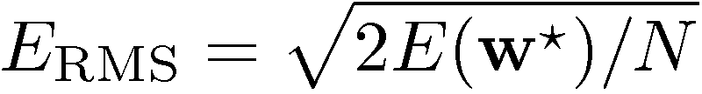
Root-Mean-Square (RMS) Error:

Slide 23
Common challenges in Machine learning models
Underfitting
Overfitting

Slide 24
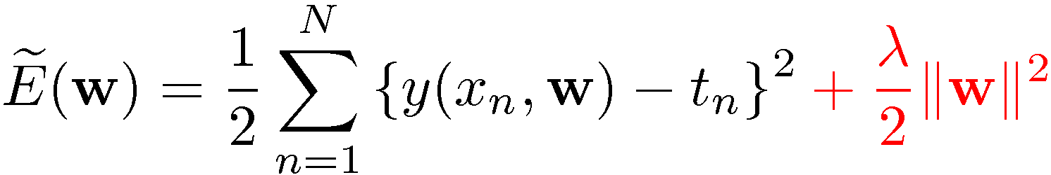
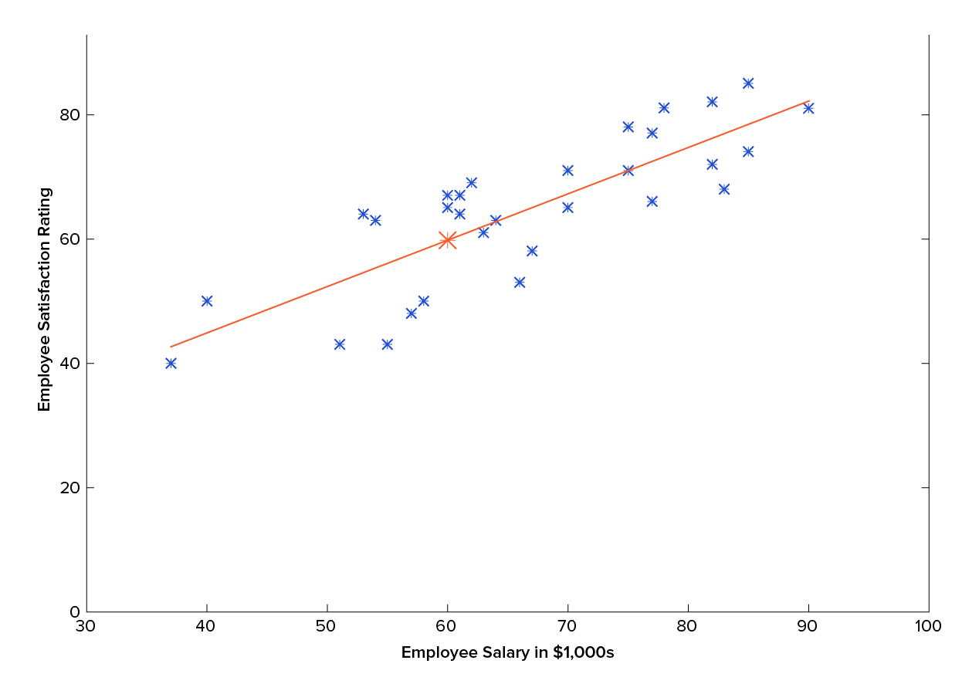
M1: Regularization refers to techniques to prevent the model from under/ overfitting

Slide 25
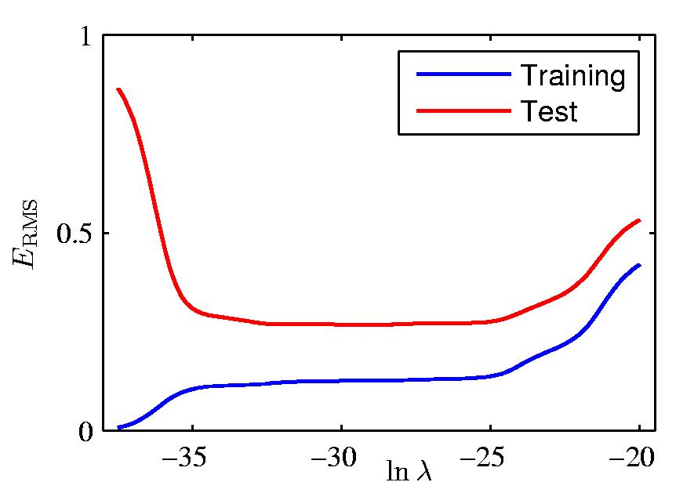
Effects of using regularization on error

Slide 26
M2: Increasing dataset can also help to overcome the problem of under/overfitting

Slide 27





















M3: Feature scaling & parameter values
𝑥₁: size (feet²)
range: 300 − 2,000
𝑥₂: # bedrooms
range: 0 − 5
= 𝑤₁ 𝑥₁ + 𝑤₂𝑥₂ + 𝑏
House: 𝑥₁ = 2000, 𝑥₂ = 5, 𝑝𝑟𝑖𝑐𝑒 = $500k
size of the parameters 𝑤₁ , 𝑤₂?
𝑤₁ = 50, 𝑤₂ = 0.1, 𝑏 = 50 𝑤₁ = 0.1, 𝑤₂ = 50, 𝑏 = 50
𝑝𝑟𝑖𝑐𝑒 = 50 ∗ 2000 + 0.1 ∗ 5 + 50 𝑝𝑟𝑖𝑐𝑒 = 0.1 ∗ 2000𝑘 + 50 ∗ 5+5 0
𝑝𝑟𝑖𝑐𝑒 = $100,050.5k 𝑝𝑟𝑖𝑐𝑒 = $500k

Slide 28
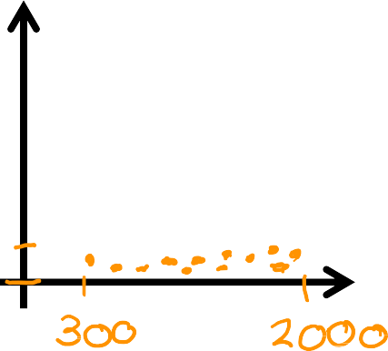




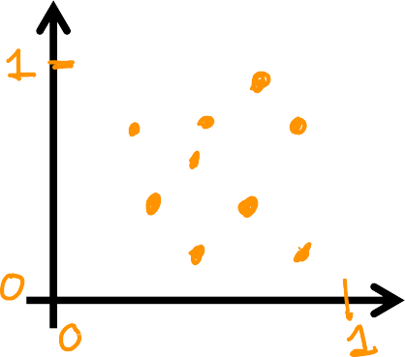



Feature scaling: Normalization
𝑥₂
# bedrooms
300 ≤ 𝑥₁ ≤ 2000
0 ≤ 𝑥₂ ≤ 5
𝑥₁ size in feet²
𝑥
𝑥
₌ 1
₌ 2
𝑥
𝑥
1,𝑠𝑐𝑎𝑙𝑒𝑑
2000
2,𝑠𝑐𝑎𝑙𝑒𝑑
5
𝑥₂
# bedrooms rescaled
0.15 ≤ 𝑥_{1,𝑠𝑐𝑎𝑙𝑒𝑑} ≤ 1
^{0 ≤ 𝑥}2,𝑠𝑐𝑎𝑙𝑒𝑑 ^{≤ 1}
𝑥₁ size in
feet² rescaled

Slide 29
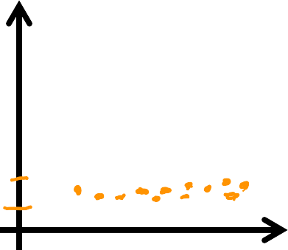









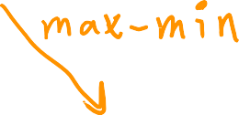
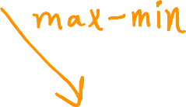





Mean normalization
300 ≤ 𝑥₁ ≤ 2000
0 ≤ 𝑥₂ ≤ 5
𝑥₂
# bedrooms
𝑥₁ − 𝜇₁
𝑥₂ − 𝜇₂
𝑥 =
𝑥 =
1
2000−300
2
5−0
𝑥 size
1
in feet²
𝑥₂
# bedrooms normalized
−0.18 ≤ 𝑥₁ ≤ 0.82
−0.46 ≤ 𝑥₂ ≤ 0.54
𝑥₁ size in feet²
normalized

Slide 30
Let’s brainstorm together
What is Regression
How regression models work?
Different types of regression models and their functioning
Common problems with regression models and how to address them

Slide 31
Optional Slides
Extra about questions ☺

Slide 32
Bias
1. Bias:
Definition: Bias represents the error introduced by approximating a real-world problem, which may be complex, by a simplified model. High bias can lead to underfitting.
Characteristics: A high-bias model is too simplistic and makes strong assumptions about the underlying data. It tends to overlook the complexity of the true relationship between input features and the target variable.
Effects: Models with high bias may consistently make the same mistakes on the training and testing data. They fail to capture the underlying patterns in the data.

Slide 33
Variance
2. Variance:
Definition: Variance represents the model’s sensitivity to small fluctuations in the training data. High variance can lead to overfitting.
Characteristics: A high-variance model is overly complex and captures noise in the training data as if it were a true pattern. It is too flexible and fits the training data too closely.
Effects: Models with high variance may perform well on the training data but poorly on new, unseen data. They are less likely to generalize to different datasets.

Slide 34
Bias-Variance Tradeoff:
The tradeoff arises because increasing model complexity typically reduces bias but increases variance, and vice versa. The goal is to find the right level of model complexity that minimizes the total error on new, unseen data.

Slide 35
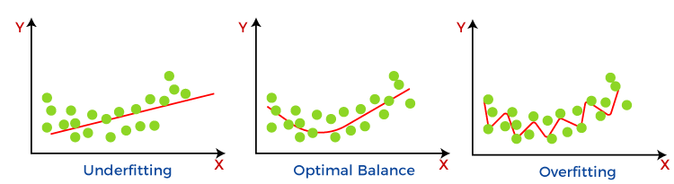
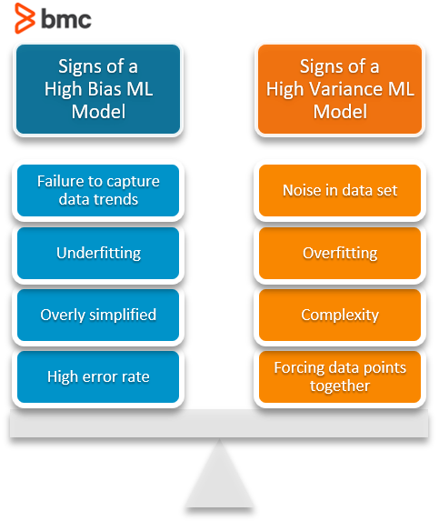
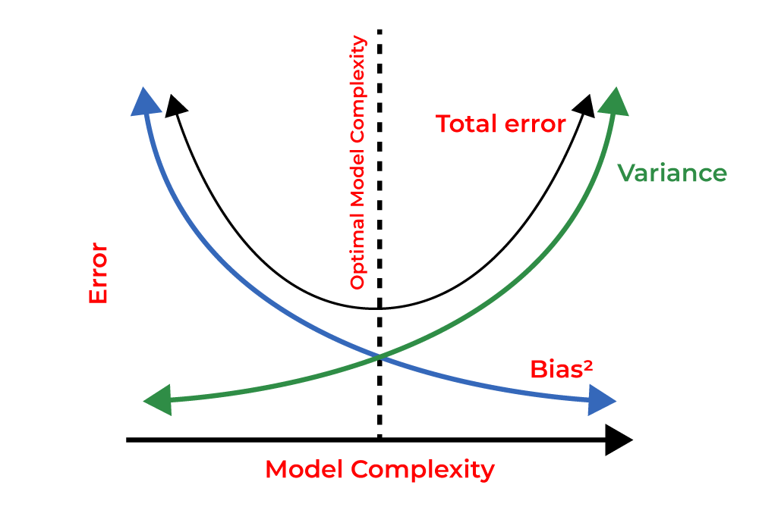
Bias and Variance

Slide 36
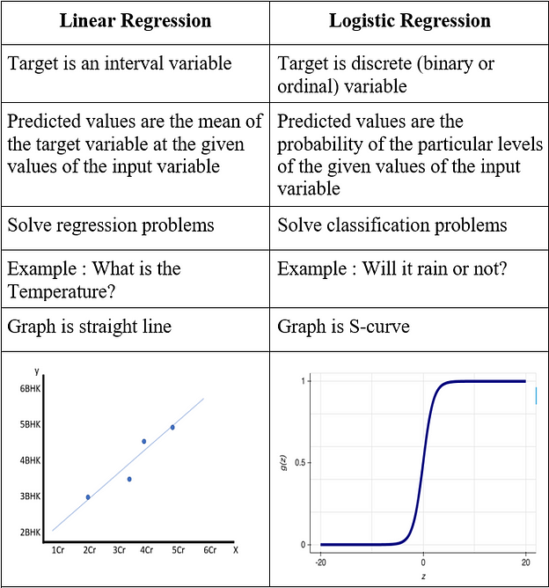
Linear vs Logistic Regression

Slide 37
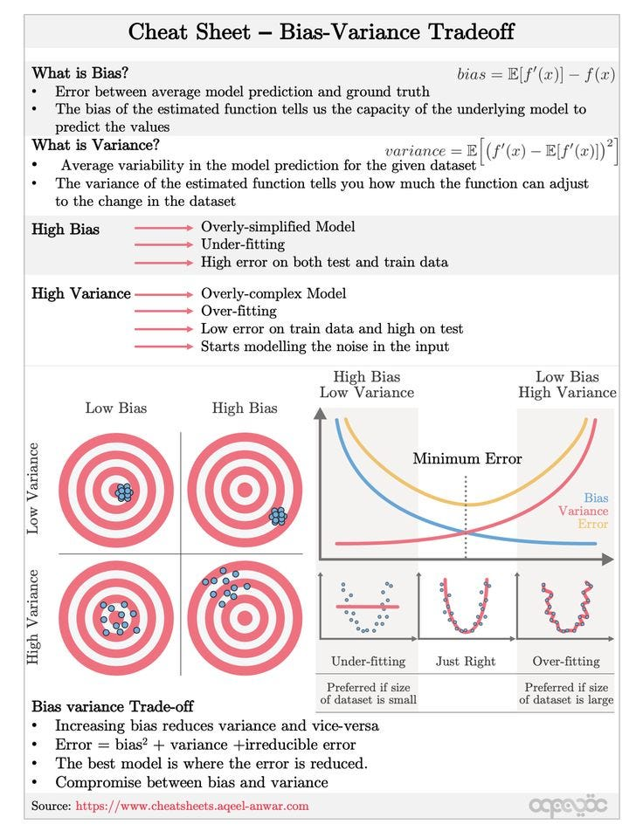

Slide 38

Happy Learning!

